Slide 1

Learn Programming For Kids (Python)

Slide 2
Lesson 4
Python Datatypes

Slide 3
8. Python Datatypes
Data types in Python are like different kinds of boxes that can store different types of things If you have different types of toys or different types of books, Python has different types of data that it can work with.

Slide 4
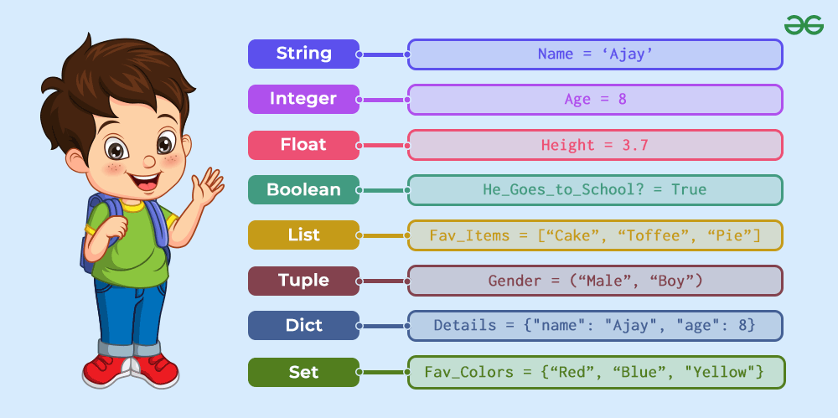

Slide 5
8.1. Integer (int):
An integer represents whole numbers without decimals. It is like a whole cookie and represents a complete number without any pieces or fractions.
For example, Our age, if someone asks us about our age, we generally give the answer in numbers without decimals like 18, 21, 11, etc.

Slide 6
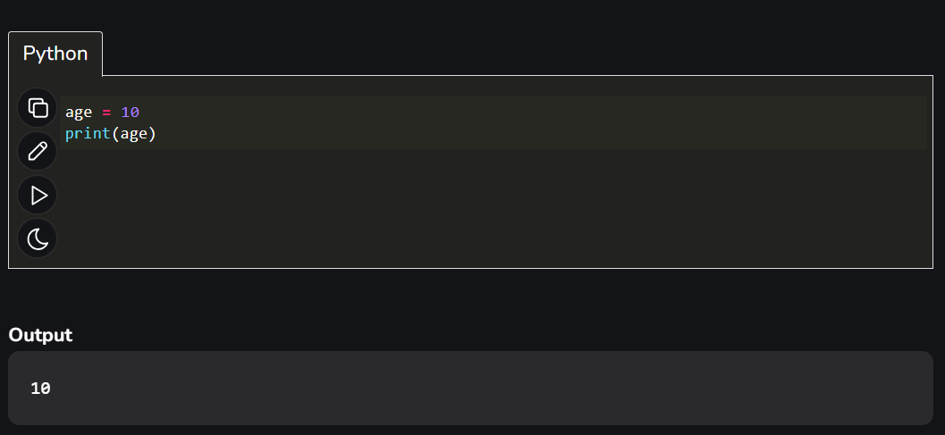
Code:

Slide 7
8.2. Float (float):
A float represents numbers with decimal points, It is like a cookie that has some pieces missing. It represents a number with a decimal or fraction. It can be used to represent measurements.
For example, We have to measure height, so it has to be concise and accurate it includes number + fractional parts in it like, 5.5, 6.7, 7, etc.

Slide 8
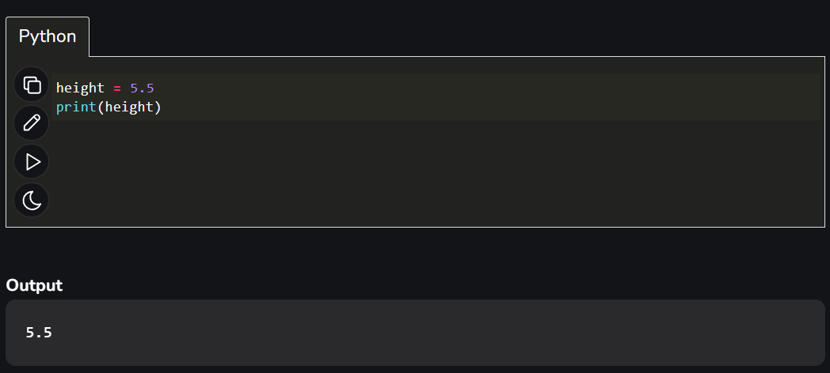
Code:

Slide 9
8.3. String (str):
A string represents a sequence of characters or alphabets. It can be used to store text-based information. The string is like a collection of letters, words, or sentences.
For example, a person’s name can be stored as strings.

Slide 10
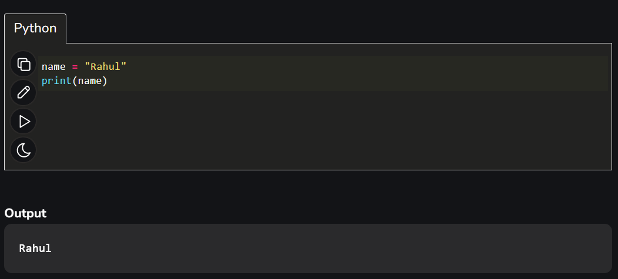
Code:

Slide 11
8.4. Boolean (bool):
A boolean represents two possible values: True or False. It deals with only true or false. A boolean is like a switch that can be either on or off. It represents a true or false value, like answering a yes or no question.
For example, Is Delhi the capital of India or not? So, the possible answer to this type of question is yes or no but in computers we communicate in true and false.

Slide 12
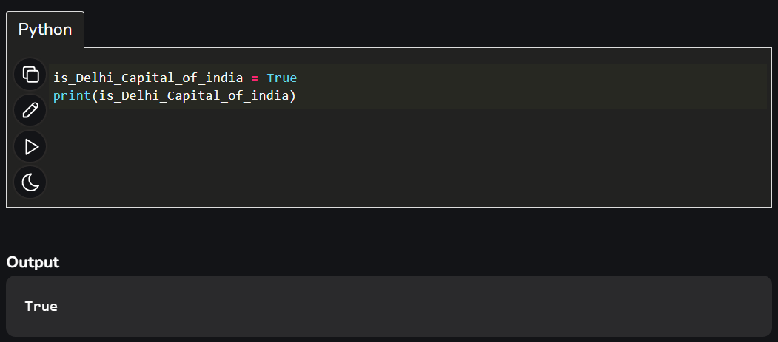
Code:

Slide 13
8.5. List:
A list is an ordered collection of items. It can be used to store multiple values of different data types. A list is like a collection of items in a basket. It can contain different things, such as numbers, words, or even other lists.
Example 1: A shopping list can contain items of different types like strings, numbers, or booleans.

Slide 14
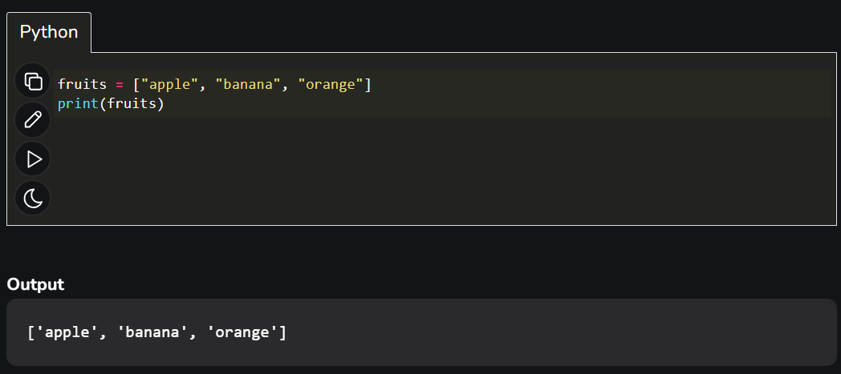
Code:

Slide 15
Let’s understand the List data type with one more example:
Example 2: Imagine you have a list of your favourite colours. You can write them down one after the other.

Slide 16
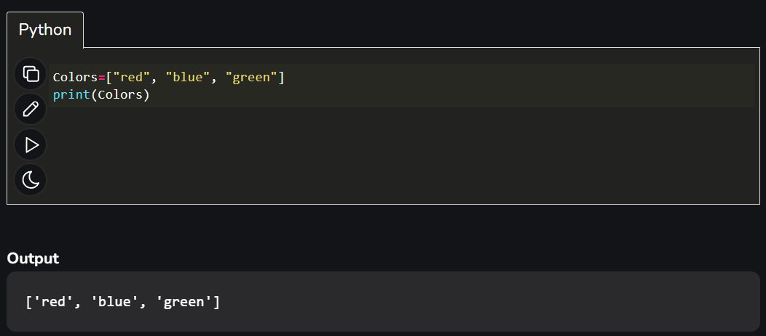
Code:

Slide 17
Note:
You can easily add or remove colors from your list whenever you want. Lists are like a collection of items that you can change or update easily, just like your list of favorite colors.

Slide 18
8.6. Tuple:
A tuple is similar to a list but is immutable, meaning its elements cannot be changed once defined. It is like a fixed sequence of items. Once it’s set, the items cannot be changed. It’s like having a locked box with things inside.
Example 1: the coordinates of a point (x, y) on a map, where the values are fixed.

Slide 19
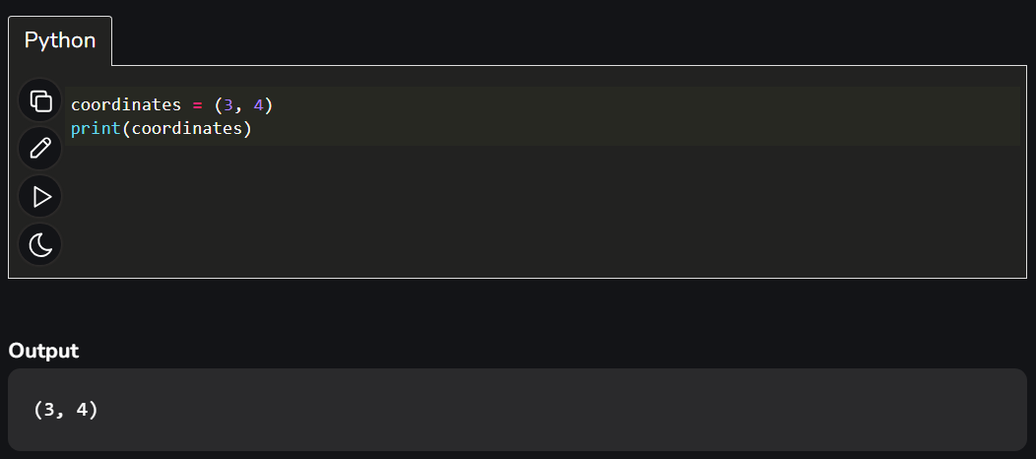
Code:

Slide 20
Let’s understand Tuple with one more example:
Example 2: You have a tuple representing the days of the week: (“Monday”, “Tuesday”, “Wednesday”). You can’t add or remove days from the tuple because it’s fixed.

Slide 21
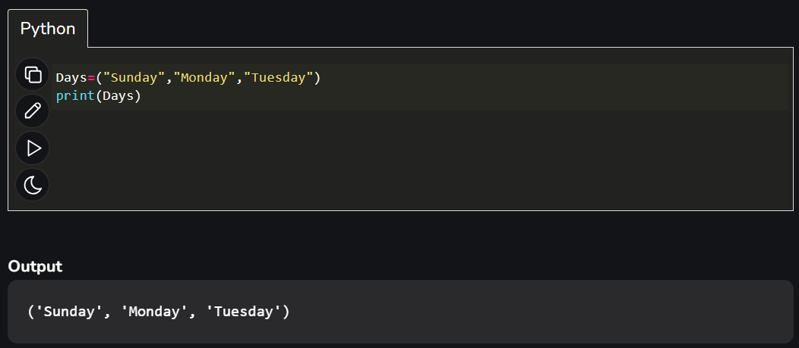
Code:

Slide 22
8.7. Dictionary:
A dictionary is an unordered collection of key-value pairs. It is useful for storing and retrieving data using specific keys. A dictionary is like a book with definitions. It has words (keys) and their meanings (values). Each word has a unique meaning.
Example 1: If we have to save details of a person then we can use the dictionary.

Slide 23
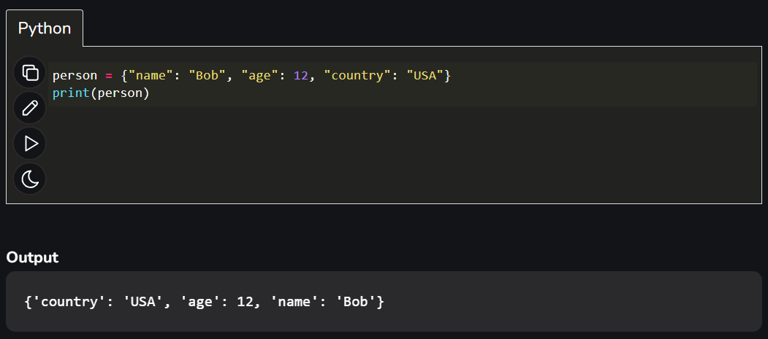
Code:

Slide 24
Let’s understand Dictionary in Python with one more example:
Example 2: Animals = {“lion”: “Lions are known as the kings of the jungle”, “elephant”: “Elephants have a great memory”}.
In this dictionary, you can look up an animal’s name and find its corresponding fun fact.

Slide 25
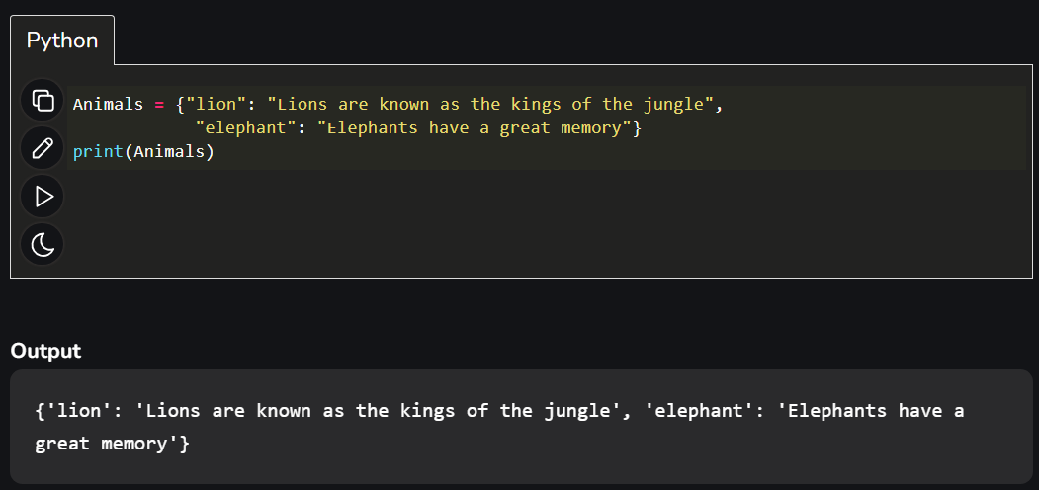
Code:

Slide 26
8.8. Set:
A set is an unordered collection of unique elements. It is a data type that allows storing multiple values but automatically eliminates duplicates.
For example, let’s say you have a set of animal stickers. You have a lion, a monkey, and a giraffe in this set. But you don’t have two lions or two monkeys, because sets only keep one of each thing.

Slide 27
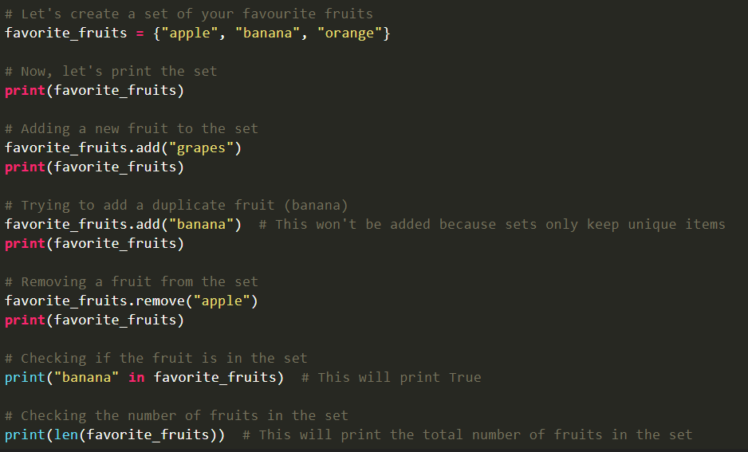
Code:

Slide 28
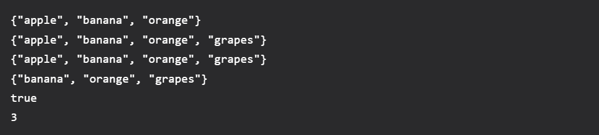
Output:

